Slide 1
A PRESENTATION ON HIBERNATE
Presented By :
Gurpreet Singh Matharu Pallavi Chhikara

Slide 2
Object Relational Mapping (ORM)
ORM stands for Object-Relational Mapping (ORM) is a programming technique for converting data between relational databases and object oriented programming languages such as Java, C# etc.
When we work with an object-oriented systems, there's a mismatch between the object model and the relational database. RDBMSs represent data in a tabular format whereas object-oriented languages, such as Java or C# represent it as an interconnected graph of objects.

Slide 3
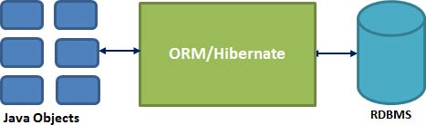
Hibernate
Hibernate is an Object-Relational Mapping(ORM) solution for JAVA and it is an open source persistent framework created by Gavin King in 2001. It is a powerful, high performance Object-Relational Persistence and Query service for any Java Application.
Hibernate sits between traditional Java objects and database server to handle all the work in persisting those objects based on the appropriate O/R mechanisms and patterns.

Slide 4
Advantages of Hibernate
Hibernate takes care of mapping Java classes to database tables using XML files and without writing any line of code.
Provides simple APIs for storing and retrieving Java objects directly to and from the database.
If there is change in Database or in any table then we only need to change XML file properties.
Abstracts away the unfamiliar SQL types and provide us to work around familiar Java Objects.
Hibernate does not require an application server to operate.
Manipulates Complex associations of objects of your database.
Minimize database access with smart fetching strategies.
Provides Simple querying of data.

Slide 5
Supported Databases
Hibernate supports almost all the major RDBMS. Following is
list of few of the database engines supported by Hibernate.
HSQL Database Engine
DB2/NT
MySQL
PostgreSQL
FrontBase
Oracle
Microsoft SQL Server Database
Sybase SQL Server
Informix Dynamic Server

Slide 6
Hibernate Architecture
The Hibernate architecture is layered to keep you isolated from having to know the underlying APIs.
Hibernate makes use of the database and configuration data to provide persistence services (and persistent objects) to the application.
Lets see a very high level view of the Hibernate Application Architecture

Slide 7
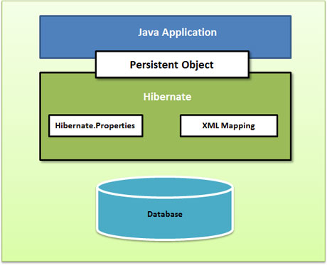

Slide 8
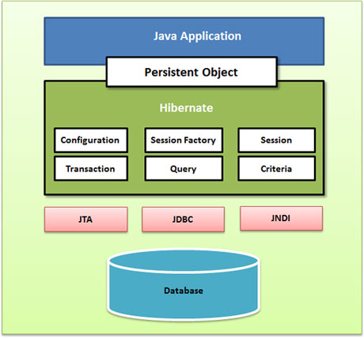
Detailed View of the Hibernate Application Architecture

Slide 9
Configuration Object
The Configuration object is the first Hibernate object you create in any Hibernate application and is usually created only once during application initialization. It represents a configuration or properties file required by the Hibernate.
The Configuration object provides two keys components:
Database Connection: This is handled through one or more configuration files supported by Hibernate. These files are hibernate.properties and hibernate.cfg.xml.
Class Mapping Setup This component establishes the connection between the Java classes and the database tables.

Slide 10
Session Factory Object
Configuration object is used to create a Session Factory object which in turn, configures Hibernate for the application using the supplied configuration file and allows for a Session object to be instantiated. The SessionFactory is used by all the threads of an application.
Also, the SessionFactory is a heavyweight object so usually it is created at the start of the application and is kept for later use. You would need one SessionFactory object per database using a separate configuration file. So if you are using multiple databases then you would have to create multiple SessionFactory objects.

Slide 11
Session Object
A Session is used to get a physical connection with a database. The Session object is lightweight and designed to be instantiated each time an interaction is needed with the database.
Persistent objects are saved and retrieved through a Session object.
The session objects should not be kept open for a long time because they are not usually thread safe and they should be created and destroyed as per our needs.

Slide 12
Transaction Object
A Transaction represents a single unit of work with the database and most of the RDBMS supports transaction functionality. Transactions in Hibernate are handled by an underlying transaction manager (from JDBC or JTA).
This is an optional object and Hibernate applications may choose not to use this interface, instead managing transactions in their own application code.

Slide 13
Query Object
Query objects use SQL or Hibernate Query Language (HQL) string to retrieve data from the database and create objects. A Query instance is used to bind query parameters, limit the number of results returned by the query, and finally to execute the query.
Criteria Object
Criteria objects are used to create and execute object oriented criteria queries to retrieve objects.

Slide 14
Hibernate Configuration
Hibernate requires to know in advance where to find the mapping information that defines how your Java classes relate to the database tables. Hibernate also requires a set of configuration settings related to database and other related parameters. All such information is usually supplied as a standard Java properties file called hibernate.properties, or as an XML file named hibernate.cfg.xml.
Following is the list of important properties you would require to configure for a databases in a standalone situation:
1. hibernate.dialect
This property makes Hibernate generate the appropriate SQL for the chosen database.

Slide 15
2. hibernate.connection.driver_class
The JDBC driver class.
3 hibernate.connection.url
The JDBC URL to the database instance.
4 hibernate.connection.username
The database username.
5 hibernate.connection.password
The database password.
6 hibernate.connection.pool_size
Limits the number of connections waiting in the Hibernate database connection pool.
7 hibernate.connection.autocommit
Allows autocommit mode to be used for the JDBC connection.

Slide 16
Hibernate Sessions
A Session is used to get a physical connection with a database. The Session object is lightweight and designed to be instantiated each time an interaction is needed with the database. Persistent objects are saved and retrieved through a Session object.
The session objects should not be kept open for a long time because they are not usually thread safe and they should be created and destroyed them as needed. The main function of the Session is to offer create, read and delete operations for instances of mapped entity classes. Instances may exist in one of the following three states at a given point in time:
Transient: A new instance of a a persistent class which is not associated with a Session and has no representation in the database and no identifier value is considered transient by Hibernate.
Persistent: You can make a transient instance persistent by associating it with a Session. A persistent instance has a representation in the database, an identifier value and is associated with a Session.
Detached: Once we close the Hibernate Session, the persistent instance will become a detached instance.

Slide 17
Hibernate Persistent Class
The entire concept of Hibernate is to take the values from Java class attributes and persist them to a database table. A mapping document helps Hibernate in determining how to pull the values from the classes and map them with table and associated fields.
Java classes whose objects or instances will be stored in database tables are called persistent classes in Hibernate. Hibernate works best if these classes follow some simple rules, also known as the Plain Old Java Object (POJO) programming model. There are following main rules of persistent classes, however, none of these rules are hard requirements.
All Java classes that will be persisted need a default constructor.
All classes should contain an ID in order to allow easy identification of your objects within Hibernate and the database. This property maps to the primary key column of a database table.

Slide 18
All attributes that will be persisted should be declared private and have getXXX and setXXXmethods defined in the JavaBean style.
A central feature of Hibernate, proxies, depends upon the persistent class being either non-final, or the implementation of an interface that declares all public methods.
All classes that do not extend or implement some specialized classes and interfaces required by the EJB framework.
The POJO name is used to emphasize that a given object is an ordinary Java Object, not a special object, and in particular not an Enterprise JavaBean.

Slide 19
Example of Persisting an Object
// get a Hibernate SessionFactory for Session management
SessionFactory = new Configuration()
.configure().buildSessionFactory();
// an Event object that we want to save
Location ku = new Location( "Kasetsart University" );
ku.setAddress( "90 Pahonyotin Road; Bangkok" );
Event event = new Event("Java Days");
event.setLocation( ku );
Session session = sessionFactory.openSession();
Transaction tx = session.beginTransaction();
session.save( event ); tx.commit();
session.close();

Slide 20
Example of Retrieving an Object
// use the existing session factory
Session session = sessionFactory.openSession();
// query Event objects for "Java Days"
Transaction tx = session.beginTransaction();
Query query = session.createQuery(
"from Event where name='Java Days'" );
List events = query.list( );
out.println("Upcoming Java Days events: ");
for( Object obj : events ) {
Event event = (Event) obj;
String name = event.getName( );
Location loc = event.getLocation( );
...
}
tx.commit( );

Slide 21
Using Named Parameters in Query
// use the existing session factory
Session session = sessionFactory.openSession();
// Hibernate Query Language (HQL) can use named params
Query query = session.createQuery(
"from Event where name=:name");
query.setParameter( "name", "Java Days");
List events = query.list( );
out.println("Upcoming Java Days events: ");
for( Object obj : events ) {
Event event = (Event) obj;
String name = event.getName( );
Location loc = event.getLocation( );
...

